Slide 1
HOWDY!
DSA IT Liaisons Communications Committee
8/4/2020

Slide 2
Agenda
Annual Security Assessment Update
Windows Feature Update 1909
Mac Desktop & Mobile Device Management
DoIT Updates
Q&A

Slide 3
Annual IT Security Risk Assessment Update
Justin Ellison
Russell Gatlin

Slide 4
IT Security Risk Assessment Update
Inventory Management:
April 21 to May 31
Completed using Google Sheet/Excel in the team drive
Internal target for inventory completion by May 15
Assessment and Review: June 1 to August 31
Completed using Rsam, the new eGRC tool
Non-IT Professional risk assessments August 10 to September 30
Reporting:
September 1 to December 18
Phase 01
Phase 02
Phase 03
Complete and submitted as of June 1, 2020.
DivIT has created Rsam accounts and provided training. DivIT is loading previous assessment data.
No updates at this time.
Notes:
Thanks to Liaisons for compiling cloud-software information
Liaisons may be asked to help with minor data collection/clarifications during Phase 2

Slide 5
Windows Feature Update 1909
(DSA Pilot Group Update)
Ariane Ray

Slide 6
Windows Feature Update 1909
UPDATE DATE | DEPTS
13-Jul | Pilot Members
27-Jul | BGCC, DMS, MUSA, SLS, UART, VRSC
3-Aug | CAPS, DRL
10-Aug | SHS, REC
17-Aug | MSC, UCEN
24-Aug | DR, ODSL, SACT
31-Aug | OOC, ROTCs, OVP/MarCom

Slide 7
DSA Pilot Group Update
Windows Feature Update 1909
Pilot Groups completed testing and two rounds of DSA rollout have been completed
Upgrades have gone well so far
Please remind users to report any issues using the Windows Feature Update Issue Reporting Form

Slide 8
Mac Management Project

Slide 9
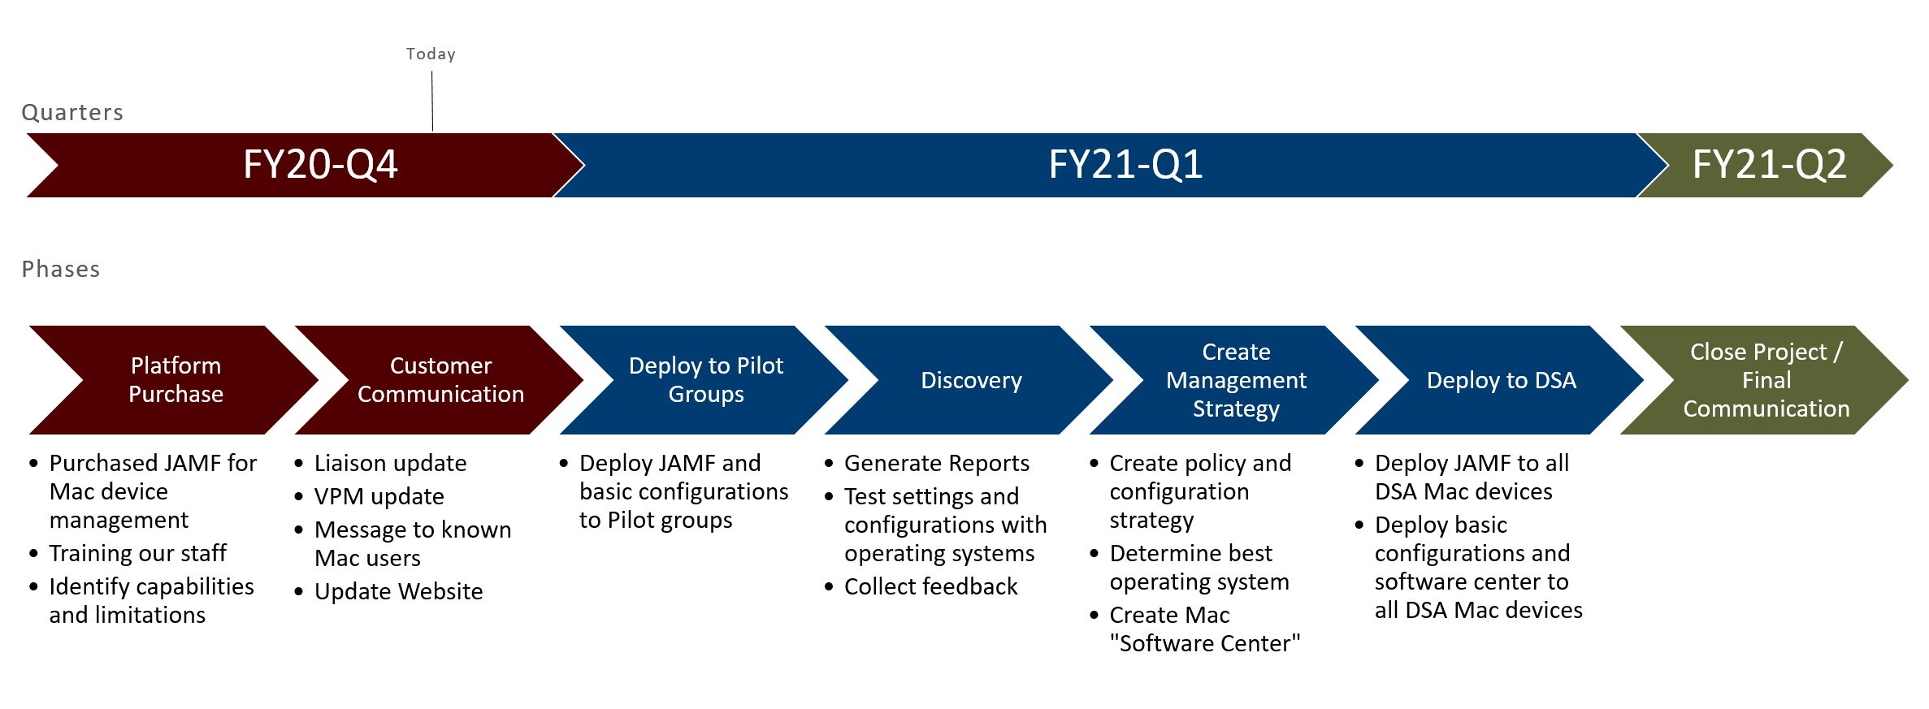
Mac Management Project

Slide 10
DoIT Updates
Position Updates: EUSS I, Admin Coord I, PM II
Annual Customer Service Survey out 8/3
Interest in a Demo of Acuity Scheduling?
End of Life for Legacy Phone Systems at TAMU
Microsoft 365 Updates

Slide 11
Department Q&A
Darvis Griffin

